Slide 1

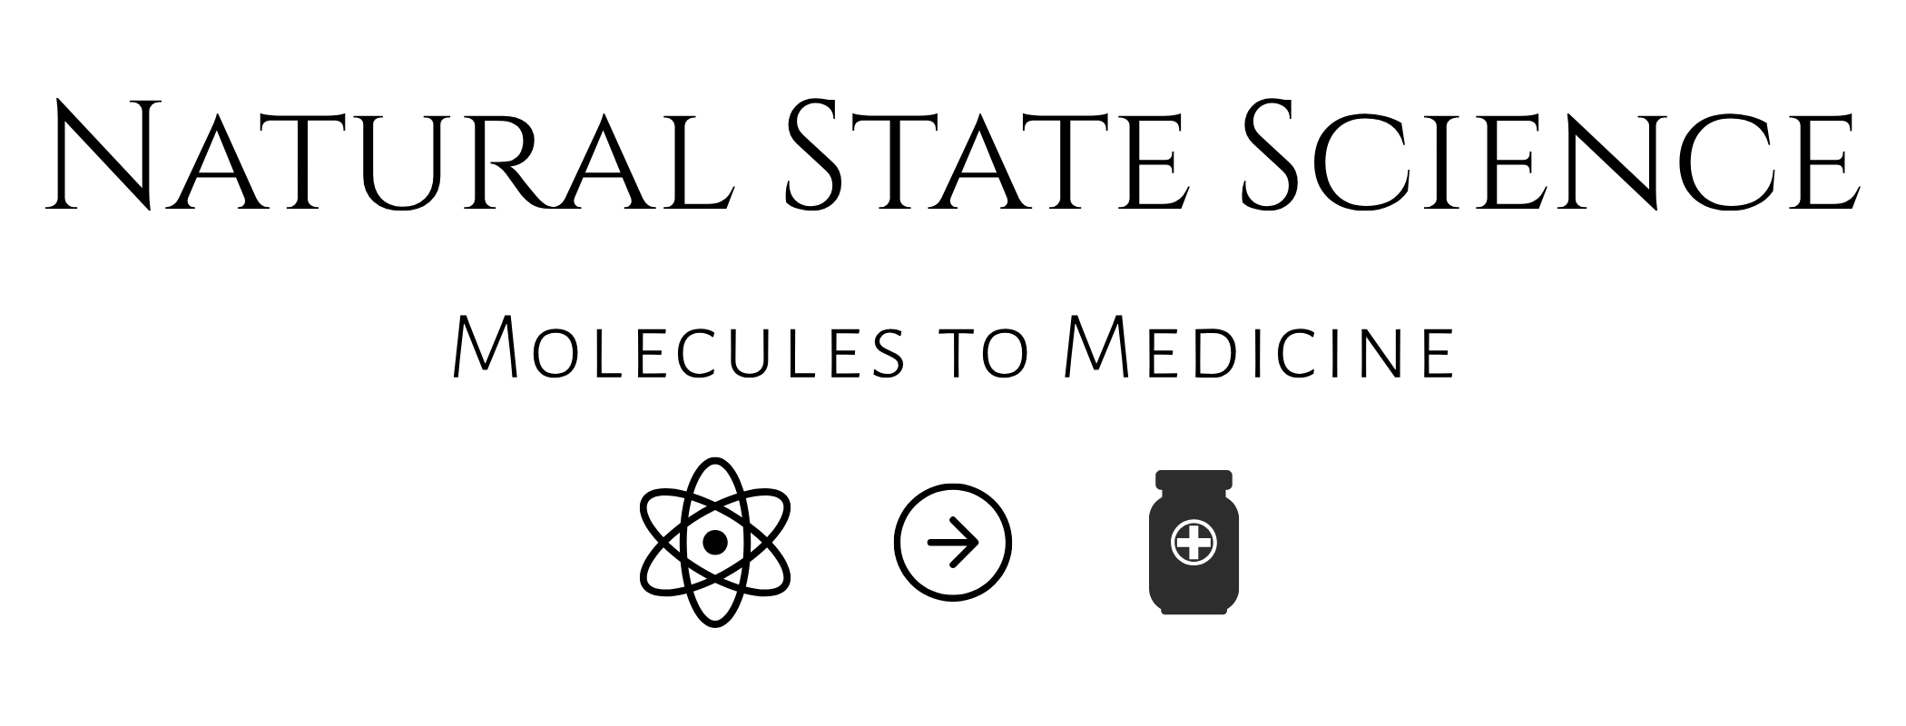
CORPORATE AND PROGRAM OVERVIEW
NSS-01
Pancreatic lead.
Broad solid-tumor reach.
NSS-01 combines HSA-focused testing, pancreatic and colorectal in vivo findings, and in vitro activity across four additional cancer types.
Non-confidential overview. Preclinical candidate. Not approved for human use.
Notes:
[Sources]
- Natural State Science logo and “Molecules to Medicine” branding supplied by the company.
- OpenAI ImageGen project tumor-microenvironment visual, August 2026; conceptual background only, no data.
- NSS-01 identity and structure: Prijovich et al., Molecular Pharmaceutics. 2016;13:1242–1250. https://pubmed.ncbi.nlm.nih.gov/26824303/
- Natural State Science Executive Summary (Doc7.docx), company-supplied August 2026; company-reported preclinical, process, formulation, and patent information.
[/Sources]

Slide 2
THREE PRECLINICAL FINDINGS
THREE FINDINGS DEFINE
THE NSS-01 OPPORTUNITY
Colorectal in vivo
Pancreatic regression
Additional solid tumors
Lower mean tumor growth in 5 of 5 matched comparisons, including studies with added HSA and HSA-expressing models.
A majority of treated subjects experienced regression in two studies. One group reached approximately 70% median regression.
Lower mean IC₅₀ than SN-38 in ovarian, bladder and breast HSA-containing cell models.
Evidence spans HSA-focused testing, two in vivo tumor systems and six solid-tumor types.
Preclinical findings. No clinical advantage has been established.
NON-CONFIDENTIAL OVERVIEW
02
Notes:
[Sources]
- Natural State Science, Data summaries Exp 3-11 Excel Extracts_November 2025_ALL Figures.xlsx.
- Natural State Science company-reported pancreatic efficacy-study findings.
- Natural State Science PCT application PCT/US2025/042138, published as WO2026039718A1, Figure 43.
[/Sources]

Slide 3
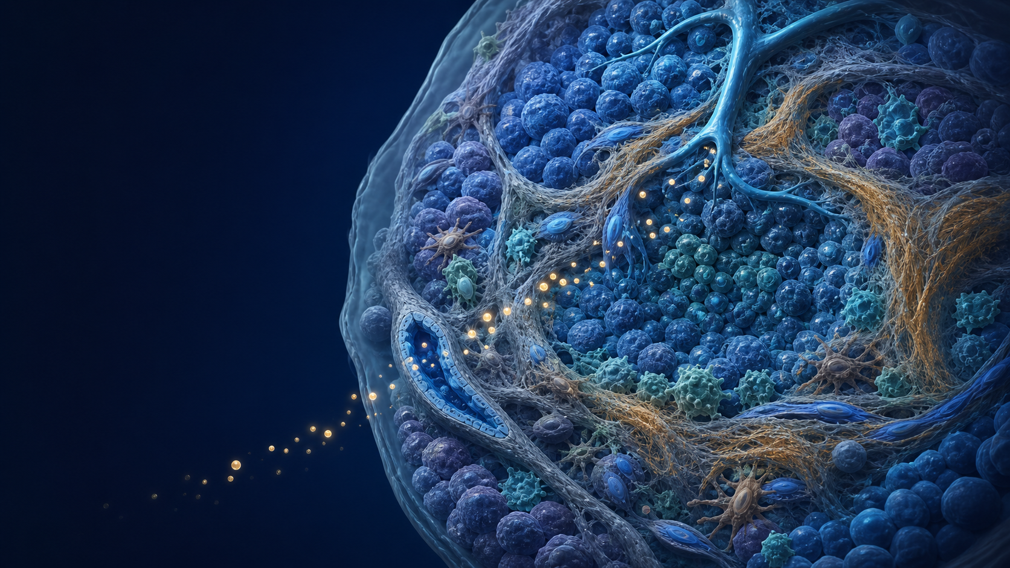
THE TRANSLATIONAL CHALLENGE
Human albumin can
alter camptothecin activity
Human relevance
HSA is the most abundant protein in human plasma
Translational risk
Albumin interactions can alter camptothecin behavior
NSS-01 was tested directly in HSA-containing assays and human-albumin-expressing animal models.
NON-CONFIDENTIAL OVERVIEW
03
Notes:
[Sources]
- Natural State Science Executive Summary (Doc7.docx), company-supplied August 2026; company-reported preclinical, process, formulation, and patent information.
- Prijovich et al., Molecular Pharmaceutics. 2016;13:1242–1250. https://pubmed.ncbi.nlm.nih.gov/26824303/
- OpenAI ImageGen visual generated for Natural State Science, August 2026; conceptual image only, no data.
[/Sources]

Slide 4
ESTABLISHED CLINICAL PRECEDENT
THE CPT CLASS IS
CLINICALLY VALIDATED
Irinotecan
Topotecan
The remaining gap
FDA-approved camptothecin derivative used in established colorectal and pancreatic cancer regimens.
FDA-approved camptothecin derivative used for ovarian, small-cell lung and cervical cancers.
Albumin interactions can alter activity, which NSS-01 testing was designed to evaluate.
NSS-01 builds on a clinically validated drug class and tests activity under HSA-containing conditions.
NON-CONFIDENTIAL OVERVIEW
04
Notes:
[Sources]
- Natural State Science Executive Summary, company-supplied August 2026.
- U.S. FDA, Topotecan Injection prescribing information, initial U.S. approval 1996: https://www.accessdata.fda.gov/drugsatfda_docs/label/2019/022453s011lbl.pdf
- U.S. FDA Drugs@FDA labeling resources for irinotecan products.
[/Sources]

Slide 5
HSA HEAD-TO-HEAD COMPARISON
NSS-01 SHOWED THE LOWEST MEAN IC₅₀
IN ALL THREE HSA-CONTAINING MODELS
Mean IC₅₀ (nM) after 24 hours with 20 mg/mL HSA. Lower IC₅₀ indicates greater antiproliferative potency.
Mean IC₅₀ (nM)
NSS-01 had a lower mean IC₅₀ than each comparator in every HSA-containing model.
SN-38 is the active metabolite of irinotecan. Preclinical cell-line findings. Triplicate MTT assay. Full methods and raw data are available for diligence.
NON-CONFIDENTIAL OVERVIEW
05
Notes:
[Sources]
- Natural State Science PCT application PCT/US2025/042138, published as WO2026039718A1 on February 19, 2026, Figure 43.
- Natural State Science company-reported in vitro study results and raw-data table.
[/Sources]
Human EJ-1 bladder, MCF-7 breast and A2780 ovarian cancer cells were exposed for 24 hours with 20 mg/mL HSA. Mean IC50 values were determined by triplicate MTT assay. Values by model (NSS-01 / SN-38 / topotecan / irinotecan, nM): EJ-1, 7.0 / 44.8 / 346.6 / 330.0; MCF-7, 29.0 / 45.7 / 408.3 / 49.5; A2780, 21.4 / 118.1 / 121.2 / 407.5.

Slide 6
COLORECTAL IN VIVO COMPARISON
NSS-01 PRODUCED LOWER MEAN TUMOR GROWTH
THAN THREE TOPO-I COMPARATORS
65% lower growth
84% lower growth
83% lower growth
NSS-01 10 mg/kg
versus SN-38 10 mg/kg
NSS-01 10 mg/kg
versus topotecan 10 mg/kg
NSS-01 10 mg/kg
versus irinotecan 20 mg/kg
Experiment 6 used HSA-expressing Rag-negative C57BL/6 mice. Treatments were divided between subcutaneous and intraperitoneal administration.
Relative reductions compare final tumor growth from baseline. Company-reported study. Full protocol, calculations and raw data are available for diligence.
NON-CONFIDENTIAL OVERVIEW
06
Notes:
[Sources]
- Natural State Science, Data summaries Exp 3-11 Excel Extracts_November 2025_ALL Figures.xlsx, Experiment 6 cells A28:A31 and O63:P93.
[/Sources]

Slide 7
FIVE MATCHED IN VIVO COMPARISONS
NSS-01 produced lower mean tumor growth in every experiment
Mean tumor growth was 42% to 65% lower than the matched comparator. Median reductions ranged from 30% to 77%.
5 of 5
matched experiments showed lower mean tumor growth
42–65%
lower mean growth across the five comparisons
30–77%
lower median growth across the same comparisons
Each experiment was analyzed independently. The chart shows the relative reduction in tumor growth versus that experiment’s matched comparator.
NON-CONFIDENTIAL OVERVIEW
07
Notes:
[Sources]
- Natural State Science, Data summaries Exp 3-11 Excel Extracts_November 2025_ALL Figures.xlsx.
- Experiment 3 cells N46:O67; Experiment 4 cells M23:N87; Experiment 6 cells O63:P73; Exp 7 and 8 cells N63:O120.
[/Sources]

Slide 8
EXPERIMENT-LEVEL CONTEXT
The directional result persisted across models, routes and comparators
Relative reductions allow comparison across experiments. Percentage-point gaps preserve the original spreadsheet calculations.
Exp. | Model and HSA context | Comparator | Administration | Mean result | Median result
3 | NOD-SCID HSA added | SN-38 + HSA | Single matched dose | 60% lower 388-point gap | 71% lower 434-point gap
4 | Nude mice | Irinotecan | Subcutaneous | 64% lower 368-point gap | 60% lower 288-point gap
6 | HSA+ Rag− C57BL/6 mice | SN-38 | 10 mg/kg total split s.c. + i.p. | 65% lower 318-point gap | 77% lower 344-point gap
7 | Older HSA+ Rag− C57BL/6 mice | SN-38 | 10 mg/kg total split s.c. + i.p. | 42% lower 365-point gap | 30% lower 191-point gap
8 | Older HSA+ Rag− C57BL/6 mice | SN-38 | 10 mg/kg total oral split into four doses | 44% lower 1,072-point gap | 56% lower 1,425-point gap
“Lower” is the relative reduction in growth. “Point gap” is the absolute difference between the comparator and NSS-01 growth percentages.
Final tumor volume was normalized to baseline. Point gaps greater than 100 can occur when tumors grow several-fold from baseline. Experiments were not pooled.
NON-CONFIDENTIAL OVERVIEW
08
Notes:
[Sources]
- Natural State Science, Data summaries Exp 3-11 Excel Extracts_November 2025_ALL Figures.xlsx.
- Experiment 3 cells N46:O67; Experiment 4 cells M23:N87; Experiment 6 cells O63:P73; Exp 7 and 8 cells N63:O120.
[/Sources]

Slide 9
Pancreatic cancer leaves patients with too few durable options
For patients and families, the need is immediate: a path to durable control.
67,530
52,740
13.7%
estimated new U.S. cases in 2026
estimated U.S. deaths in 2026
five-year relative survival
LATE DETECTION COMPOUNDS THE CHALLENGE
51% of cases are diagnosed after distant spread. Five-year survival at that stage is 3.4%.
Sources: NCI SEER Cancer Stat Facts: Pancreatic Cancer and ACS Cancer Facts & Figures 2026
NON-CONFIDENTIAL OVERVIEW
09
Notes:
[Sources]
- NCI SEER. Cancer Stat Facts: Pancreatic Cancer. https://seer.cancer.gov/statfacts/html/pancreas.html
- American Cancer Society. Cancer Facts & Figures 2026.
- Natural State Science logo supplied by the company.
[/Sources]

Slide 10
PANCREATIC IN VIVO EVIDENCE
PANCREATIC TUMOR REGRESSION
IN TWO PRECLINICAL STUDIES
Tumor regression
Depth of response
Metastatic findings
A majority of treated animals showed tumor regression in each study, lasting 3 and 4 weeks.
One group showed 25% mean and approximately 70% median tumor-volume regression.
No metastases observed in either NSS-01 treatment group during the study periods.
Control groups showed rapid tumor growth and metastatic findings during the evaluated periods.
Company-reported studies. No treatment-attributable findings precluding continued development within the parameters assessed. Group sizes, methods and raw data available for diligence.
NON-CONFIDENTIAL OVERVIEW
10
Notes:
Study separation, control observations and qualified tolerability statement follow Bryce Warren’s supplied descriptions. Metastatic observations are limited to the study periods; no claim of prevention or clinical safety is made. Group sizes were not supplied for this revision.

Slide 11
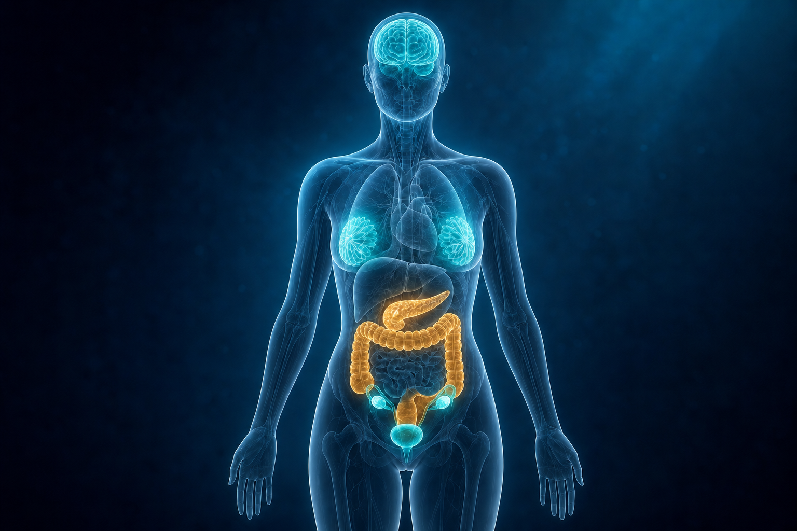
NSS-01 testing spans six solid tumor types
Pancreatic and colorectal models include in vivo work. Four additional cancers extend the in vitro evidence.
ANATOMICAL BREADTH OF THE NSS-01 PROGRAM
Pancreatic adenocarcinoma
In vitro + in vivo evidence
Colon / colorectal
In vitro + in vivo evidence
Four additional tumor systems
Ovarian, bladder, breast and glioblastoma
Gold: includes in vivo evidence. Teal: in vitro evidence
NON-CONFIDENTIAL OVERVIEW
11
Notes:
[Sources]
- Natural State Science Executive Summary (Doc7.docx), company-supplied August 2026.
- Natural State Science company-reported in vitro and in vivo study packages.
- Custom anatomical illustration generated with OpenAI ImageGen, August 2026. The illustration is conceptual and locational; it is not experimental evidence, medical imaging, or a depiction of an individual study subject.
[/Sources]

Slide 12
QUANTIFIED IN VITRO BREADTH
NSS-01 SHOWED LOWER MEAN IC₅₀ VALUES
THAN SN-38 IN THREE HSA-CONTAINING MODELS
Ovarian
82% lower
Bladder
84% lower
Breast
36% lower
Versus SN-38, the most potent comparator in this model.
Versus SN-38, the most potent comparator in this model.
Versus SN-38, the most potent comparator in this model.
Glioblastoma activity was also observed in company testing with and without HSA.
NON-CONFIDENTIAL OVERVIEW
12
Notes:
[Sources]
- Natural State Science Executive Summary, company-supplied August 2026; company-reported in vitro studies.
- Natural State Science company-reported ovarian, bladder, breast, and glioblastoma study packages.
[/Sources]

Slide 13
NSS-01 combines an established mechanism with HSA-focused testing
The lead program centers on unconjugated NSS-01, with conjugated forms in parallel exploratory development.
MECHANISM
BIOLOGY
Topoisomerase I inhibitor
Activity evaluated in HSA-containing assays and human-albumin-expressing models
NSS-01
C₂₃H₂₀N₂O₅
CANDIDATE FORM
DEVELOPMENT
Unconjugated NSS-01
Microwave synthesis process and formulation options
NON-CONFIDENTIAL OVERVIEW
13
Notes:
[Sources]
- Sugimori et al., Journal of Medicinal Chemistry. 1998;41:2308–2318. https://pubs.acs.org/doi/10.1021/jm970765q
- Prijovich et al., Molecular Pharmaceutics. 2016;13:1242–1250. https://pubmed.ncbi.nlm.nih.gov/26824303/
- Natural State Science Executive Summary (Doc7.docx), company-supplied August 2026; company-reported preclinical, process, formulation, and patent information.
[/Sources]

Slide 14
Natural State Science
Molecules to Medicine
More than five years developing NSS-01, with pancreatic and colorectal cancer as the initial therapeutic focus.
Bryce Warren, PhD
Co-Founder
Kimo Stine
Chief Medical and
Clinical Consultant
Program development and strategic partnering
Prior clinical research at Arkansas Children’s Hospital
Pediatric oncology background
Former Arkansas Children’s faculty and Children’s Oncology Group member
Transaction scope: NSS-01, proprietary synthesis, formulations and developing conjugated forms.
NON-CONFIDENTIAL OVERVIEW
14
Notes:
Source: Bryce Warren’s supplied company and leadership descriptions, including his stated prior clinical research at Arkansas Children’s Hospital and identification of Kimo Stine as NSS Chief Medical and Clinical Consultant, former pediatric oncology faculty and COG member. No additional affiliations, employment or clinical milestones are asserted.

Slide 15
Proprietary synthesis and formulation development
The lead program centers on unconjugated NSS-01. Conjugated forms remain in exploratory development.
PROPRIETARY SYNTHESIS
DELIVERY
NSS-01 synthesis with analytical controls for product composition
Colloidal nanoparticle system
NSS-01
C₂₃H₂₀N₂O₅
FORMULATION
CONJUGATED FORMS
Up to 2.3-fold higher measured water solubility with nanocrystal formulation in company testing
Exploratory targeted-delivery research
The synthesis process is part of the proposed transaction. Commercial-scale validation is not claimed.
NON-CONFIDENTIAL OVERVIEW
15
Notes:
The proprietary synthesis designation follows the company’s description. Existing formulation result is retained without new validation. Efficacy data in this presentation concern unconjugated NSS-01, not developing conjugated forms.

Slide 16
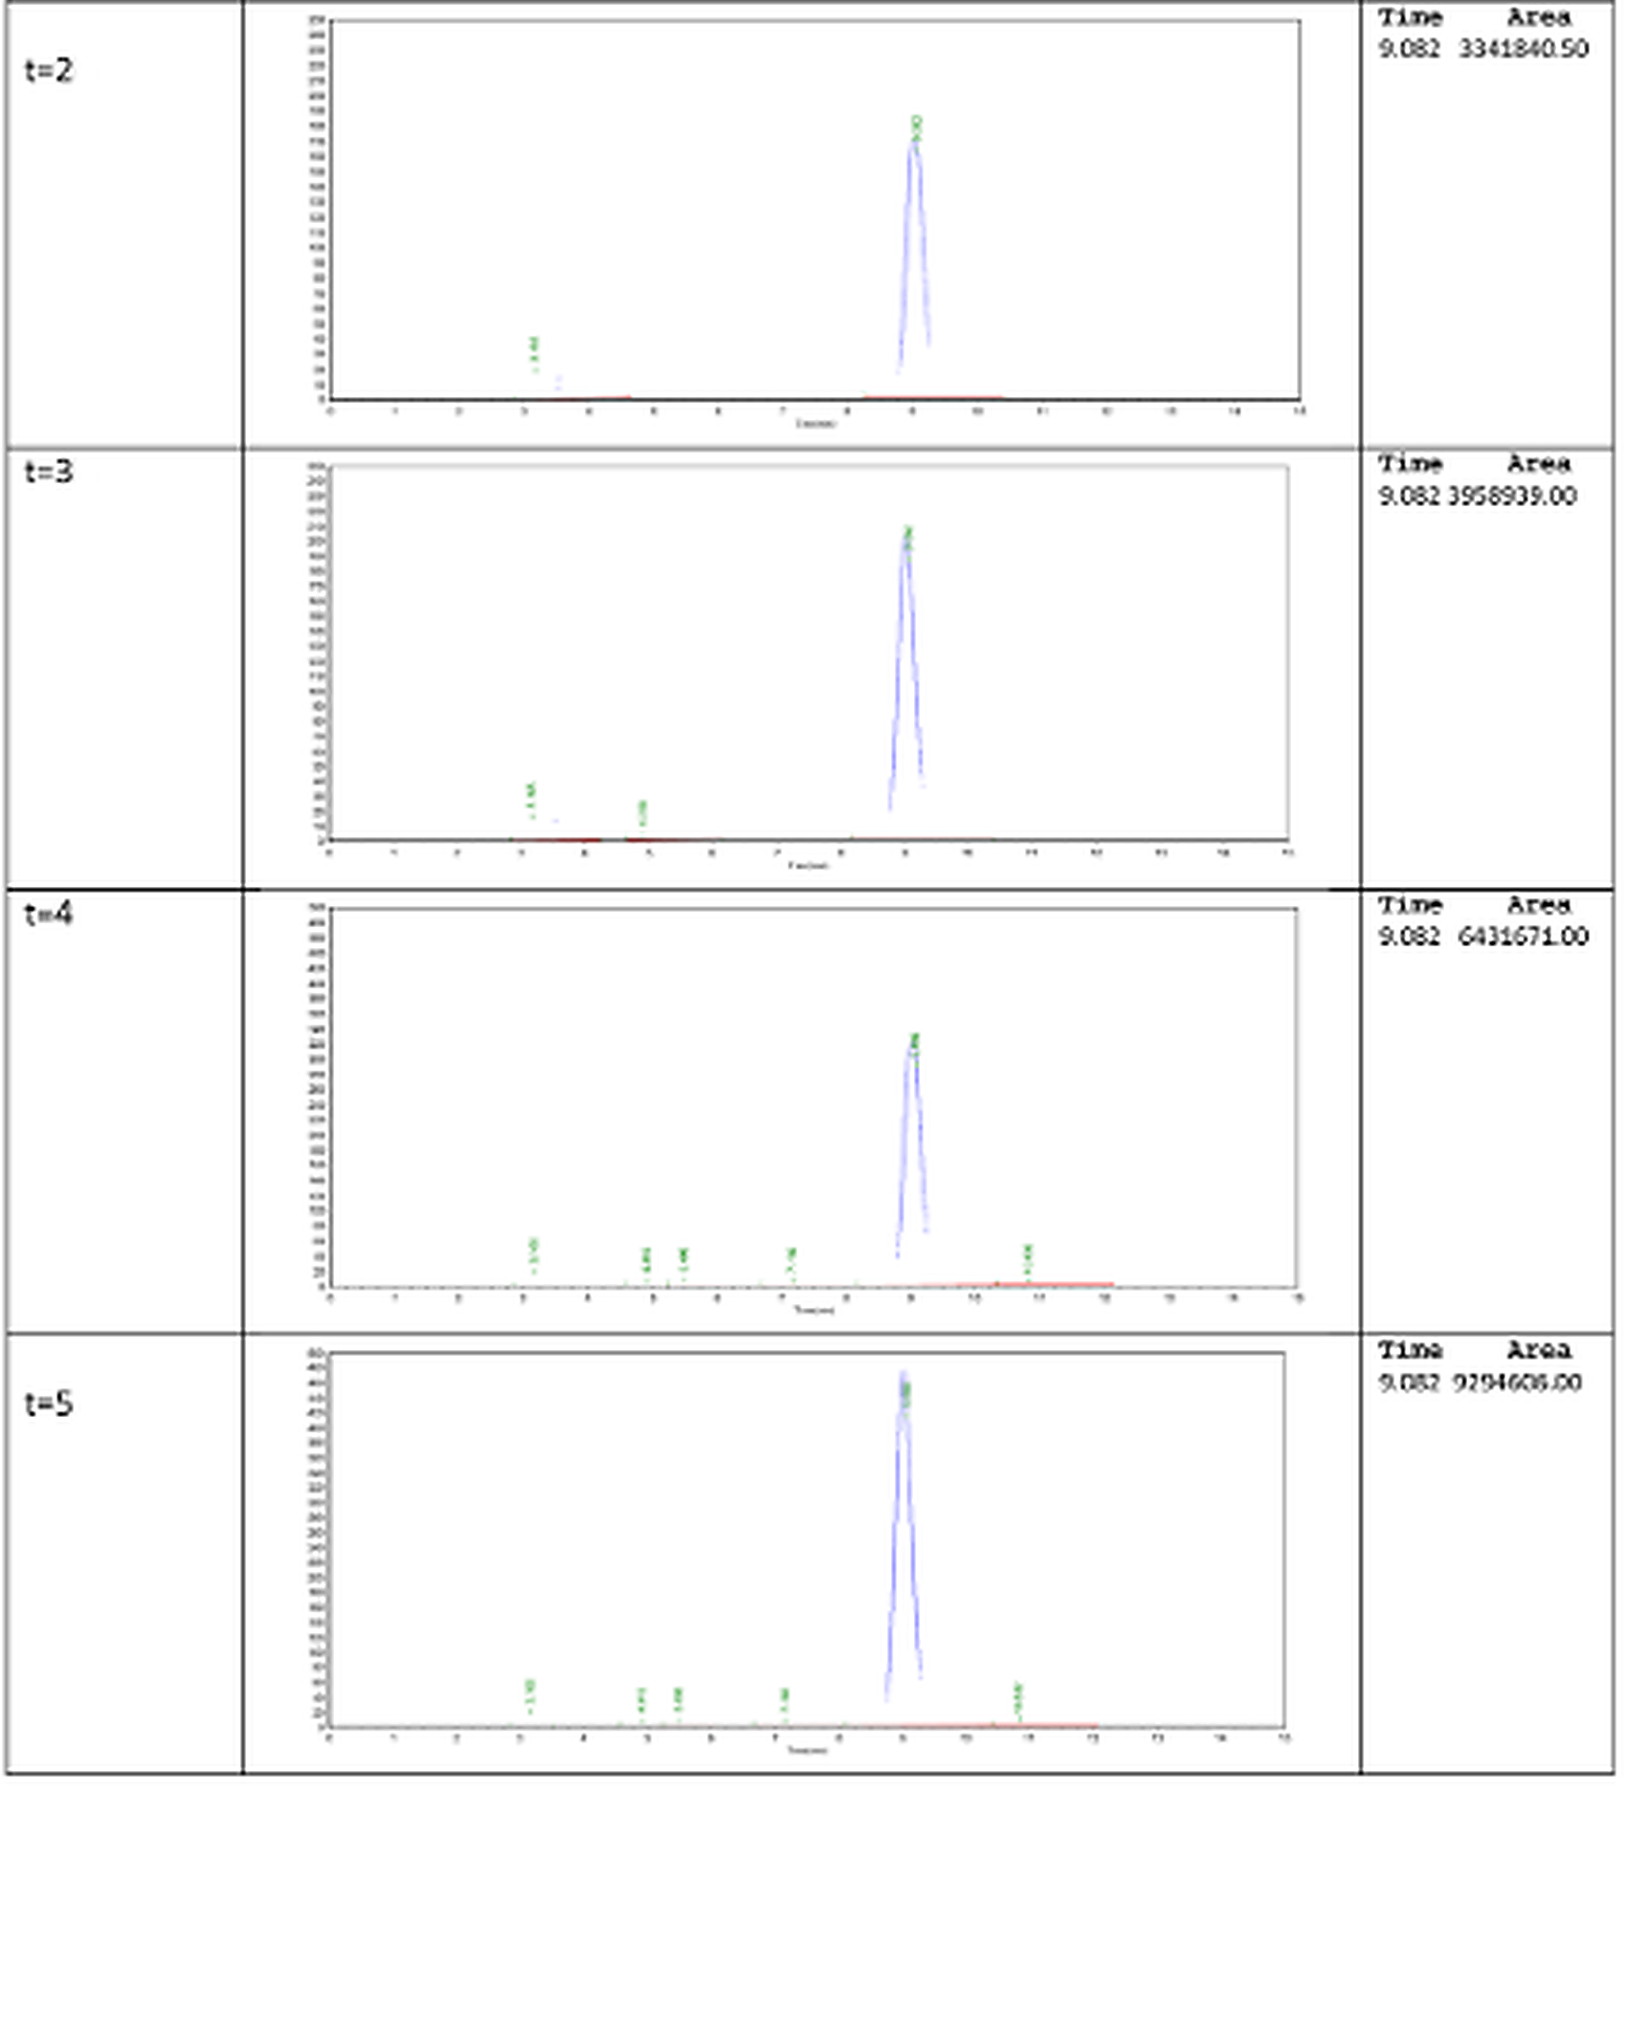
Published PCT application covers multiple development pathways
Published claims address therapeutic use, synthesis and formulation. Claim scope remains subject to examination.
PCT/US2025/042138 / WO/2026/039718
Therapeutic use
Methods of treating cancer by administering NSS-01.
Synthesis and product quality
Published claims include synthesis and formulation embodiments involving >93% desired product.
Priority foundation
Priority claimed to U.S. provisionals dated Aug. 16, 2024 and Apr. 9, 2025.
Published Feb. 19, 2026. Pending. Claim scope and validity remain subject to examination
NON-CONFIDENTIAL OVERVIEW
16
Notes:
[Sources]
- WIPO PATENTSCOPE, PCT/US2025/042138, published as WO/2026/039718 on February 19, 2026: https://patentscope.wipo.int/
- Natural State Science Executive Summary, company-supplied August 2026.
- Natural State Science microwave-synthesis chromatography summary and corrected chromatogram supplied in this workspace.
[/Sources]

Slide 17
Pancreatic-led development plan
Current priorities advance the lead indication while preserving evidence-led follow-up in other tumors.
01
02
03
04
Preclinical evidence
CMC development
Program focus
IND-enabling work
Pancreatic and colorectal efficacy studies with HSA comparator assays
Analytical controls, formulation work and scalable candidate supply
Pancreatic lead program with evidence-led follow-up in colorectal and other tumors
Formal PK/PD, toxicology, exposure-response and regulatory planning
Formal pharmacokinetic and safety studies remain part of the IND-enabling plan.
ILLUSTRATIVE DEVELOPMENT PRIORITIES / NON-CONFIDENTIAL OVERVIEW
17
Notes:
[Sources]
- Natural State Science Executive Summary, company-supplied August 2026; company-reported tolerability observations.
- Natural State Science internal program planning assumptions.
[/Sources]

Slide 18

NSS-01 DEVELOPMENT AND TRANSACTION
Advancing NSS-01
toward clinical development
The program combines comparative preclinical findings with proprietary synthesis, formulation work and developing conjugated forms.
Development partnership, licensing agreement
or acquisition of the NSS-01 program
Bryce Warren, PhD | Co-Founder | Natural State Science
501-454-0102 | bwarren@naturalstatescience.com
Notes:
[Sources]
- Natural State Science logo supplied by the company.
- OpenAI ImageGen project tumor-microenvironment visual, August 2026; conceptual background only, no data.
- Natural State Science Executive Summary, company-supplied August 2026.
[/Sources]

